Slide 1


Department Of Computer Science

Slide 2
Final Report Project Title (Valid Title, reflecting scope and objectives)
Student 1 Name
Student 1 Registration Number.
Student 2 Name
Student 2 Registration Number.
Supervisor:
Supervisor Name
Department Of Computer Science
Submission Date: Day-Month-Year

Slide 3
Scope

Slide 4
Abstract
Note: 1 Slide only
Provide 4-6 line sentences as summary of your project. Briefly describe the project is trying to achieve. It should be comprehensive, and concise.

Slide 5
Project Category
Note: 1 Slide only
Based on your project type, write the appropriate Category / Categories of your project.
A- Desktop Application/Information System
B- Web Application/Web Application based Information System
C- Problem Solving and Artificial Intelligence
D- Simulation and Modeling
E- Smartphone Application
F- Smartphone Game
G- Networks
H- Image Processing
I- Other (specify category) ______________________

Slide 6
Introduction
Note: 1 Slide only
Based on your proposed project type, specify the purpose of your project.
Mention the key goals of selecting the project.
Provide the local, international and professional impact.

Slide 7
Introduction
Note: 1 Slide only
Based on your proposed project type, specify the purpose of your project.
Mention the key goals of selecting the project.
Provide the local, international and professional impact.

Slide 8
Problem Statement
Note: 1- Slide
Based on your proposed project type, discuss the following items:
What problems does your software solve?
Why you are developing this system?
Does the similar system already exist? If yes, how will the re-implementation help your learning?
What skills do you expect to learn from this project?

Slide 9
Problem Solution
Note: 1 - Slide
Based on your proposed project type, explain how your project/system will solve the problems mentioned in the problem statement.

Slide 10
Advantages/Benefits of Proposed System
Note: 1 Slide Only
Based on your proposed project type, mention at least 5-7 advantages and benefits of your proposed project in bullets/numbering

Slide 11
Related System Analysis/Literature Review
Note: 1 - 2 Slides
Based on your proposed project type, discuss at least three existing systems related to your proposed project.
(Note: Research based projects may provide literature review instead of related system analysis.)
Application Name | Weakness | Proposed Project Solution
The name of related application(s). | Weaknesses may include limited features, low quality functionality and processes. | The way the proposed project mitigates the weaknesses.
System/Application 1
System/Application 2
System/Application 3

Slide 12
Scope
Note: 1 Slide Only
Based on your proposed project type, Write down the scope of your project in logical flow with consistency.
Briefly define the major functionalities of the proposed project.
Use appropriate terms of Software Design, Development and Engineering

Slide 13
Modules
Note: 5-8 Slides
Note: Usually atleast 5-6 Modules for 2 student’s projects and 8-9 modules for 3 student’s project
Based on your proposed project type, List down the modules of the proposed project in this slide and then explain the modules in next slides. While writing the modules Don’t forget to mention special/new features for each module.
Module 1: Module-1 Name
Module 2: Module-2 Name
Module 3: Module-3 Name
Module 4: Module-3 Name
Module 5: Module-5 Name
Module 6: Module-6 Name

Slide 14
Module-1: Module Name
Note: 1 Slide/Per Module
Briefly give the details of module, along with its major features.
Write in logical flow with user aspect.

Slide 15
System Limitations/Constraints
Note: 1 Slide Only
Write down the valid limitations and constraints of the proposed project.

Slide 16
Software Process Methodology
Note: 1 Slide Only
Process Methodology
Based on your proposed project type, mention the Process Methodology you will follow for project implementation and give valid reasons why you selected this?
Design Methodology
Based on your proposed project type, mention the design Methodology you will follow for project implementation and give valid reasons why you selected this?.

Slide 17
Tools and Technologies
Note: 1 - 2 Slides
Based on your proposed project type, mention all the hardware/software tools and technologies with version number which will be used in implementation of the project. Write about the APIs, language(s), SDK(s) etc. which you will use for implementation. You should have strong reasons for choosing these tool and technologies
Tools And Technologies | Tools | Version | Rationale
 | MS Visual Studio | 2015 | IDE
 | MS SQL Server | 2015 | DBMS
 | Adobe Photoshop | CSC 6 | Design Work
 | MS Word | 2015 | Documentation
 | MS Power Point | 2015 | Presentation
 | Pencil | 2.0.5 | Mockups Creation
 | Technology | Version | Rationale
 | C# | 6.0 | Programming language
 | SQL | 2013 | Query Language
 | Html | 5 | Web Development

Slide 18
Team Members Individual Tasks/Work Division
Note: 1 Slide only
Write down the work division and task break down of each student with the roles.
Student Name | Student Registration Number | Responsibility/ Modules
Student 1Name | Student 1 Registration Number | Describe the work division of each student along with modules E.g. (Module1-Module3) Augmented reality and Databases tasks.
Student 2 Name | Student 2 Registration Number

Slide 19
Data Gathering Approach
Note: 1 Slide only
Write down information and requirement gathering approaches for proposed project e.g. Interview, Questionnaire, Discussion along with references and reasoning etc.

Slide 20
Concepts
Note: 1 - 2 Slides
Based on your proposed project type, mention the concepts that you will learn for implementing the proposed project.
For example: Code injection, Closures, Algorithm, AI techniques, Image Processing techniques etc. Example to write concepts are mentioned
Concept-1: Concept Name E.g. Augmented Reality (Briefly give the overview of concept with respect to your project)

Slide 21
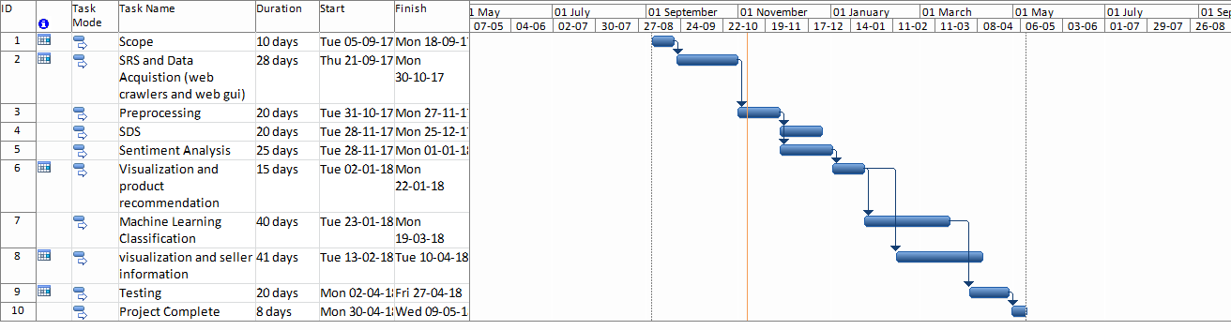
Gantt Chart
Note: 1 Slide only
Create the Grant Chart and provide estimated start and end dates of all proposed modules/tasks for each team member. Also identify the dependencies (which tasks cannot be started/completed, until the dependent task is completed).
Gantt chart can be created using MS Project.

Slide 22
Mockups
Note: 6-8 Slides
Based on your proposed project type, Insert mockups of major modules that you have mentioned in scope slide.
Do not include common mockups such as Login, Signup, Forgot Password, Contact Us, About Us etc.
Based on your proposed project domain, If the project cover multiple domains e.g. Web and Smartphone Application then include at-least three mockups from each domain of your project.
Insert the mockups in proper flow and give valid caption to mockups. E.g. Mockup-1: Main Home Page of Application.

Slide 23
SRS

Slide 24
Block Diagram of Proposed Project
Note: 1 Slide
Show the block diagram of your system with labels. For Example:
Figure-1: Block Diagram of Project Name.

Slide 25
Requirement Elicitation Techniques
Note: 1-2 Slides
List down the requirement elicitation techniques you have selected for requirement gathering approach along with reasons.
There can be multiple techniques as well depending upon proposed project.
Give valid references

Slide 26
Use Case Diagrams
Note: 1 Slide/Per Diagram (Usually 2-5 Slides)
Insert Use Case Diagrams as per Actors wise and with proper labeling and caption.
Usually (2- diagrams)
Create Use Case Diagram Using MS VISIO (or any other standard UML supported Tool) as per UML standard notations.

Slide 27
Use Case Diagram –Use Case Tittle
Place one use case diagram per slide.
Place use case diagram as per actor wise.
Figure-3 Use Case Diagram

Slide 28
List of Use Cases Module Wise Module-1: Module Name
Note: 1-2 Slides/Per Module (Usually 12-15 Slides)
Insert List of Use Cases table/per module with Functional Requirements and Hyper Link them.
For Each Module Create separate table.
On Clicking the hyper link, pdf file should be open for relevant use case of the module.
Example:
Module 1: User Management (Hyper Link for Tabular Use Cases)
Use Case Id | Use Case Title | Use Case Description | Functional Requirement
UC-Andriod-1.1 | Signup | Professor and student will create their account in “Application Name”. | Hyper Link the FR Of this use case.
UC-Android-1.2 | Login | Professor and student will provide right credential in order to login and use “Application Name”. | Hyper Link the FR Of this use case.
UC-Android-1.3 | Change Password | Professor and student will be able to change his/her password. | Hyper Link the FR Of this use case.
UC-Android-1.4 | Recover Password | Professor and student will be able to recover his/her password. | Hyper Link the FR Of this use case.
UC-Android-1.5 | Edit Details | Professor and student will be able to update his/her profile information. | Hyper Link the FR Of this use case.

Slide 29
Non-Functional Requirement
Note: 2-3 Slides
List all the Non Functional Requirements and Quantify them
Title | Performance Requirements
NFR-1 | Requirements about resources required, response time, transaction rates, throughput, benchmark specifications or anything else having to do with performance. The system’s performance characteristics should be outlined in this section
Title | Reliability
NFR-2 | Requirements for reliability of the system should be specified here
Title | Usability
NFR-3 | Requirements about how difficult it will be to learn and operate the system. The requirements are often expressed in learning time or similar metrics. This section should include all those requirements that affect usability
Title | Supportability
NFR-4 | This section indicates any requirements that will enhance the supportability or maintainability of the system being built, including coding standards, naming conventions, class libraries, maintenance access, maintenance utilities
Title | Design Constraints
NFR-5 | This section should indicate any design constraints on the system being built. Design constraints represent design decisions that have been mandated and must be adhered to
Title | Security
Nfr-6 | One or more requirements about protection of your system and its data. The measurement can be expressed in a variety of ways (effort, skill level, time, ...) to break into the system. Do not discuss solutions (e.g. passwords) in a requirements document

Slide 30
SDS

Slide 31
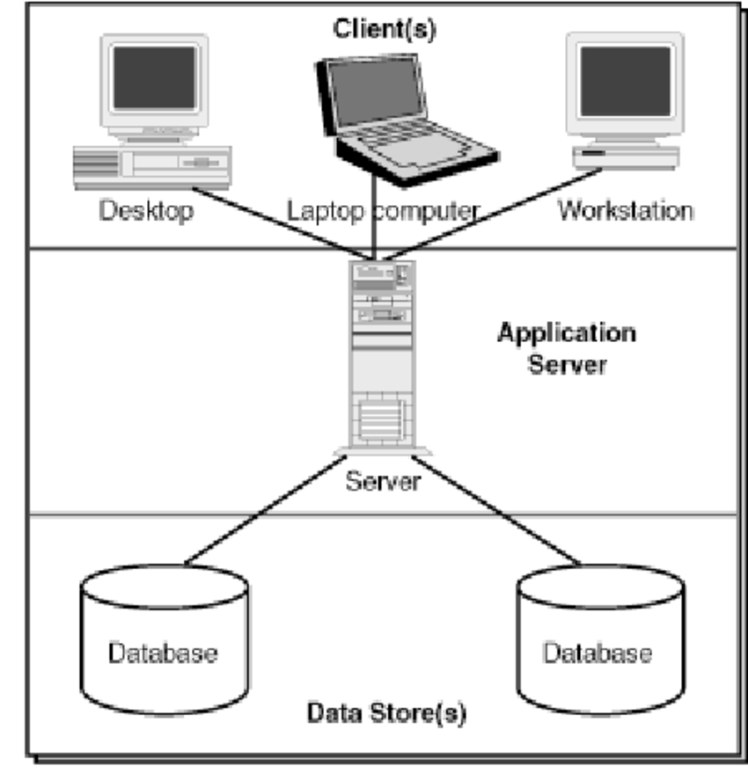
Architecture Diagram of Proposed Project
Note: 1 Slide
Show the Architecture diagram of your system with labels. For Example:
Figure-2: Client-Server Architecture Diagram

Slide 32
Process Flow Diagram of Proposed Project
Note: 1 Slide
Show the process flow diagram of your system with labels. For Example:
Figure-1: Process Flow Diagram –

Slide 33
Activity Diagrams
Note: 1 Slide/Per Diagram (Usually 2-3 Slides) -
Based on your project type, discuss the activity diagrams (atleast 4 diagrams).
Create Activity Diagrams Using MS VISIO (or any other standard UML supported Tool) as per UML standard notations.
Note: Make sure that diagrams are properly labelled, clear, readable and visible.

Slide 34
Activity Diagram of Project Name
Activity Diagrams For Module-1: Module Name
Place one activity diagram per slide.
Place activity diagram as per module wise.
Figure 5: Activity Diagram For Module

Slide 35
Class Diagram or Data Flow Diagrams
Note: 1 Slide/Per Diagram (Usually 1-2 Slides) -
Based on your project type, discuss the class diagram or Data Flow Diagram.
In case of DFD, discuss level 0, 1 and 2
Create Diagram Using MS VISIO (or any other standard UML supported Tool) as per UML standard notations.
Note: Make sure that diagrams are properly labelled, clear, readable and visible.

Slide 36
Sequence Diagram
Note: 1 Slide/Per Diagram (Usually 2-3 Slides) -
Based on your project type, discuss the sequence diagrams (atleast 4 diagrams) in 2-3 slides
Create Sequence Diagrams Using MS VISIO (or any other standard UML supported Tool) as per UML standard notations.
Note: Make sure that diagrams are properly labelled, clear, readable and visible.

Slide 37
Sequence Diagram of Project Name
Sequence Diagram For Module-1: Module Name
Place one Sequence Diagram per slide.
Place Sequence Diagram as per module wise.
Figure 8: Sequence Diagram of Project Name

Slide 38
Schematic Diagram (Only for Hardware Projects)
Note: 1 Slide/Per Diagram (Usually 1-2 Slides) -
Based on your project type, discuss the Schematic diagram in 1-2 slide.
Create Schematic Diagram Using MS VISIO (or any other standard UML supported Tool) as per UML standard notations.
Note: Make sure that diagrams are properly labelled, clear, readable and visible.

Slide 39
Timing Diagram (Only for Hardware Projects)
Note: 1 Slide/Per Diagram (Usually 1-2 Slides) -
Based on your project type, discuss the Timing diagram in 1-2 slide.
Create Timing Diagram Using MS VISIO (or any other standard UML supported Tool) as per UML standard notations.
Note: Make sure that diagrams are properly labelled, clear, readable and visible.

Slide 40
Data Representation [ERD, XML schema,JSON Schema ]
Note: 1 Slide/Per Diagram (Usually 1-2 Slides) -
Based on your project type, discuss, in case you are using a database, create an ERD for it.
Create ERD Diagram Using MS VISIO (or any other standard UML supported Tool) as per UML standard notations.
In case you are not using a database, present which ever format you are using to represent the data of your system such as XML Schema, JSON Schema etc.
Usually (2- diagrams maximum)
Note: Make sure that diagrams are properly labelled, clear, readable and visible.

Slide 41
Algorithms

Slide 42
Algorithm & Implementation
Note: Usually 2-4 Slides
Mention the algorithm(s) used in your project to get the work done with regards to major modules.
Provide a pseudocode OR a natural language explanation regarding the functioning of main features.
Be sure to use the correct syntax and semantics for algorithm representations in 2-3 slide

Slide 43
Human Computer Design
Note: Usually 1-2 Slides
Based on your project type, Present your major modules actual screens (atleast 1-2 screen per module)
Overview of User Interface: DO NOT include screens for login, signup, forgot password etc.
Display screenshots showing the interface from the user’s perspective.

Slide 44
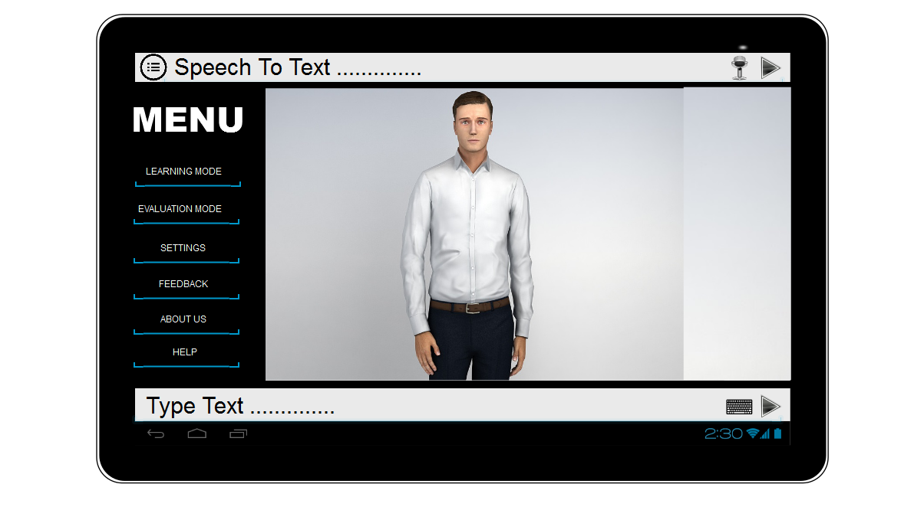
User Interfaces
Note: 1-2 Slides/Per Module
Insert all the user interfaces with proper caption as per each module.
For EXAMPLE:
Interface-1: Main Screen Of application

Slide 45
Testing

Slide 46
Testing Methodology
Note: Usually 1 Slides
Mention the Selected testing methodology(s) used in your project with reasons.

Slide 47
List of Test Case Cases Module Wise Module-1: Module Name
Note: 1-2 Slides/Per Module (Usually 12-15 Slides)
Insert List of Test Cases table/per module and Hyper Link them.
For Each Module Create separate table.
On Clicking the hyper link, pdf file should be open for relevant test case of the module.
Example:
Module 1: User Management (Hyper Link for Tabular Test Case)
Test Case Id | Test Case Title | Test Case Description | Test Case Detail
TC-Andriod-1.1 | Verify Signup | Professor and student will create their account in “Application Name”. | Hyper Link the FR Of this use case.
TC-Android-1.2 | Verify Login | Professor and student will provide right credential in order to login and use “Application Name”. | Hyper Link the FR Of this use case.

Slide 48
Lesson Learnt
Note: 1-2 Slide only
Write all lessons that your learnt while doing this semester project
Write both aspects Technical and Non-Technical.
Each Group Member write its own lesson learn as well.

Slide 49
Lesson Learnt
Student Name and Registration # | Lesson Learned
Student 1 Name: Student 1 Registration Number:
Student 2 Name: Student 2 Registration Number:

Slide 50
Work Break Down
Note: 1-2 Slide only
Write each team member work done in whole project.
Each member will write his/her own work done.

Slide 51
Work Break Down
Milestones | Student 1 Name Student 1 Registration Number | Student 2 Name Student 2 Registration Number
SCOPE Document and SCOPE presentation
SRS Document and SRS Presentation
SDS Document and SDS Presentation
Project Design (Figma and Implementation)
Project Test Plan and Presentation
Project Final Report and Presentation

Slide 52
Reviews Details
Milestones | Reviewer -1 Comments (Student-1 name and details) | Reviewer -2- Comments (Student-2 name and details)
SCOPE Document and SCOPE presentation
SRS Document and SRS Presentation
SDS Document and SDS Presentation
Project Design (Figma and Implementation)
Project Test Plan and Presentation
Project Final Report and Presentation
Feedback and Acceptance status of Reviewer Comments

Slide 53
Conclusion
Note: 1 Slide only
Conclude your project presentation.

Slide 54
References
Note: 1 Slide only
Mention the books, research papers, web links etc.
Insert references in this slide.
Use standard referencing style

Slide 55
Plaragism Report
Note: 1 Slide only
Attach the Plaragism report of your project scope document from library staff of turnitin tool (http://turnitin.com)

Slide 56
Demonstration
Demonstration of One Major Module implementation of Proposed Project.

Slide 57

Questions and Answers

